Slide 1
NurseryPro Project Presentation
Vinod Kumar Mittapally- 700# 700751764
Rajakala Jaldi 700# 700744420
Date: 01 - Dec - 2023

Slide 2
INTRODUCTION
Project Overview:
Optimizing Nursery Operations
Addressing challenges in task management and
progress tracking
Inventory management and Business.

Slide 3
WebApp Description
Web-based application for nurseries and gardening businesses.
Plants availability and contact information for customers
Streamlines task delegation, progress tracking, and inventory management.
Improves efficiency and communication for workers and owners.

Slide 4
Functionalities
Worker:
View assigned tasks.
Update assigned tasks with progress.
Request assistance from owner.

Slide 5
Functionalities
Owner:
All Worker functions.
Activate or block the new/existing user accounts.
Create, update and delete tasks.
Approve or reject worker requests.
Create sale orders and Purchase orders.
Manage inventory requests.

Slide 6
Pages
Features
MVC model
Used Session and Cookies
Implemented Post Redirect Get
Implemented basic security and sanitization
Technologies
HTML, CSS, JavaScript, jQuery, Bootstrap.css
PHP

Slide 7
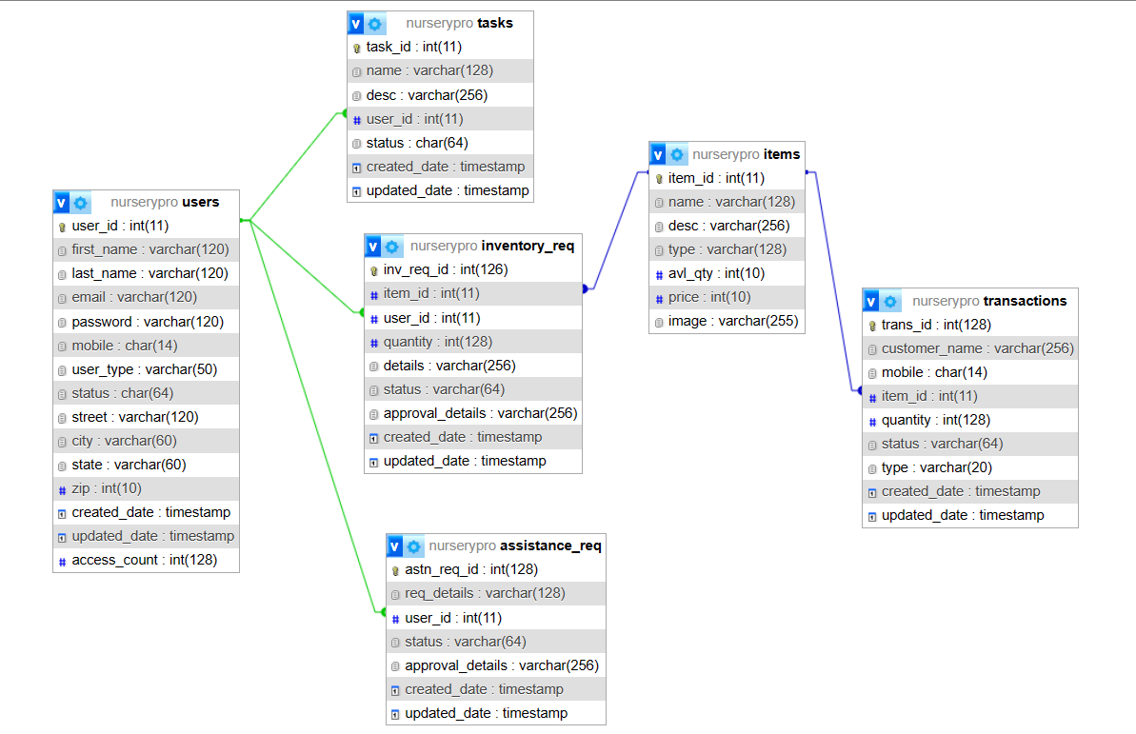
Database Objects

Slide 8
THANK YOU
Vinod Kumar Mittapally
RajaKala Jaldi

